Slide 1
Software Protection Techniques for software and IP protection
Leonardo Regano
leonardo.regano@unica.it
PhD Course on Software Security and Protection
University Of Cagliari, Italy

Slide 2
Attacker model: Man-at-the-End
an attacker that has full access and privileges on one endpoint
physical access to devices where the software runs
full control on all the components
unlimited access to analysis tools
static analysis: disassemblers, decompilers
dynamic analysis: debuggers, fuzzers
symbolic analysis, concolic analysis
simulators, virtualizers, emulators
full control of the central memory
side channel, fault injection
dedicated HW
tools are indispensable as they represent data in useful way
the human mind is the bottleneck
control flow graph, data dependency graph, call graph, symbolic/concolic states
Part of this presentation is based on the slides presented by Prof. Cataldo Basile in the Security Verification and Testing course at Politecnico di Torino.

Slide 3



Software protection
…protect the assets in software applications
property of the developing company
reputation, marketing
the most important assets?
intellectual property
algorithms, methods, architectures, protocols, patents
data
private, sensitive, personal, …
secrets, cryptographic secrets, passwords, …
other company values
GDPR, production halted
software protections mitigate risks associated to software attacks

Slide 4
Economics of MATE attacks
make more difficult to use tools to reverse engineer programs and represent data
anti-reverse engineering
€/day
make understanding the code more difficult
obfuscation
protections
make modifications more difficult (detect, prevent, react)
anti-tampering
attack building
exploitation
time

Slide 5
Economics of MATE attacks
limit the copies affected by attacks
diversification
€/day
diversity
protection
attack identification
exploitation
time

Slide 6
Economics of MATE attacks
update the software and its protections
renewability
€/day
diversity
renewability
protection
attack building
exploitation
time

Slide 7
Practical principles of software protection
most attackers are driven by the monetization
“if your code is too complex to attack, I’ll find another SW”
defenders’ aim is...
....discourage attackers by giving the (maybe true) impression that your software is well-protected and it will be hard to compromise it...
...so that they will compromise the code of some other companies…
Mors tua vita mea

Slide 8




How software is protected, nowadays
companies specialized in software protections
may follow your development process since the design of the application
select and apply (proprietary) protections
security-through-obscurity and extremely aggressive licenses
definitely not cheap!
only a few companies can afford their services
streaming/content delivery
banks and insurance companies
there are open-source protections as well
developed at some universities
not that close to the real world and often unusable by companies
no competencies in software protection / non-compliant with industrial standards
hard to use, apply, automate, maintain…

Slide 9
Software protections: categorization
by the attack steps prevented
anti-reverse engineering
avoid the use of specific classes of tools
... without tools no way to finish an attack task in time
obfuscation
make the program much more difficult to understand for human beings
anti-tampering
avoid, detect or even react to non-authorized changes to program code or behaviour
by where the protection is applied
online (remote) vs. offline techniques (local)
by the abstraction where they operate
source code vs. binaries

Slide 10

How to evaluate protections
Collberg introduced the idea of potency
just an abstract measure
tell how good the protection is
however, there is not a formula to measure it
two approaches
1. objective metrics
LOC, Hasted complexity, cyclomatic complexity, I/O calls, etc.
up to 44 theoretical metrics introduced in a recent paper
potency → formula based on objective metrics
2. empirical experiments
controlled experiment that involve people (e.g., students)
measure the times and the successes and derive evaluation of the effectiveness
https://iris.polito.it/retrieve/handle/11583/2747308/265778/190725_EMSE_AssessmentCodeSplitting.pdf

Slide 11
How to evaluate protections
limitations
high values of the metrics do not necessarily correspond to what people perceive as complex
even worse: experts are usually able to see patterns in supposedly complex code
measuring effectiveness with experiments would require millions of experiments
isolate application-specific characteristics
difficult to involve a large number of subjects
difficult to involve experts
composition of different techniques
open issues
find meaningful measures of the potency
define formulas that work in practice
mix objective metrics + empirical approach
use predictive approaches

Slide 12
Layered protection
single protection is (usually) not enough
since the target is delaying attackers
applying more protections has proven to be much more effective
more than one protection also on the same piece of code
some protection have complementary behaviours
anti-tampering + more forms of obfuscation seems to work very well
composition models that work well with potency features
es. compose obfuscation (delay comprehension) with anti-tampering (delay modifications)
also involve remote techniques if feasible
1000 anti-tampering guards used by skype-pre-Microsoft

Slide 13
Overhead
protection does not come for free
all the protections add several forms of overhead
overheads compared to the original application
complex code is not as optimized as the original one
pieces of bogus code
pieces of code for checking the integrity
communications with remote servers
new data added only needed for the protections
switching to other processes for anti-tampering code, built-in debuggers
overhead depends on both protections and original code
bandwidth, CPU cycles, memory, often
...then software developers focus on user experience

Slide 14
Reverse engineering
“the process of extracting the knowledge or design blue-prints from anything man-made”
common practice in numerous fields
mechanical engineering
biology
military
software reverse engineering a.k.a. program comprehension a.k.a program understanding
“the process of identifying software components, their inter-relationships, and representing these entities at a higher level of abstraction ”

Slide 15
Reverse engineering
can be legitimate
a sw developer that must use a poorly documented API of a open-source library
from a legal standpoint, it’s legitimate…
…unless explicitely forbidden in sw EULA…
…but EU/US software rights law allow it for interoperability purposes
e.g. Microsoft SMB (Server Message Block) → Samba in Linux-based OSes
still, we must protect software against it
anti-reverse engineering protections a.k.a software obfuscation

Slide 16
Obfuscation
family of protection techniques that aim at reducing the understandability of the code
they aim at delaying the attacker
high-level methods and principles are well-known and stable
new versions (i.e., implementation) are presented
security-through obscurity by company
few public obfuscators
diablo (Ghent university) for binaries
tigress for source code (University of Arizona at Tucson)
LLVM also has a trivial obfuscator
the dream of perfect obfuscation has been rejected by a 2001 paper
“On the (im)possibility of obfuscating programs”
i.e., there are functions that cannot be obfuscated
obfuscation is also a form of anti-static analysis protection
iacr.org/archive/crypto2001/21390001.pdf

Slide 17
Obfuscation: aims and categories
code obfuscation purposes
make the control flow unintelligible
control flow flattening
branch functions
hide external calls
add bogus control flow: opaque predicates
manipulate functions to hide their signatures
split/merge
avoid static reconstruction of the code, force dynamic analysis
just-in-time techniques, virtualization obfuscation, self-modifying code
analysis
anti-taint analysis, anti-alias
data obfuscation
simple forms that hide constants and values
white-box cryptography to hide keys in code

Slide 18
Control Flow Flattening (CFF)
transform the code so that it hides its original control flow
increase the time and effort the attacker needs to understand the protected function logic
force attackers to run dynamic analysis
while usually CFG obtained with static analysis
other technicalities
different types of "dispatch," i.e., how the next block is selected
switch, goto, indirect, call
the order of blocks can be randomized
basic blocks kept intact or split up into statements

Slide 19
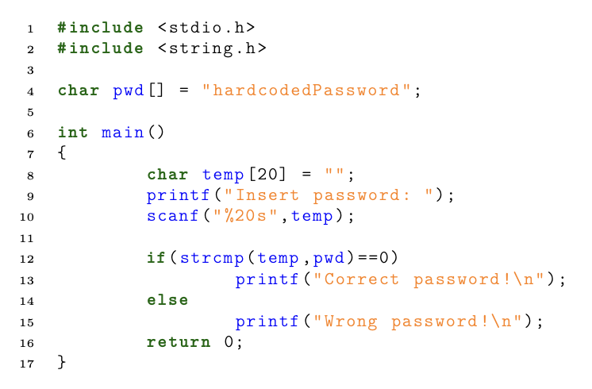
Control Flow Flattening (CFF): example

Slide 20
Control Flow Flattening (CFF): example

Slide 21
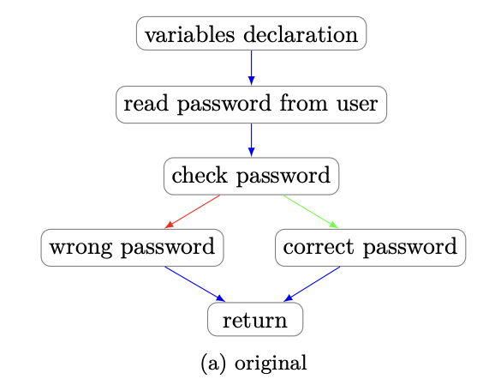
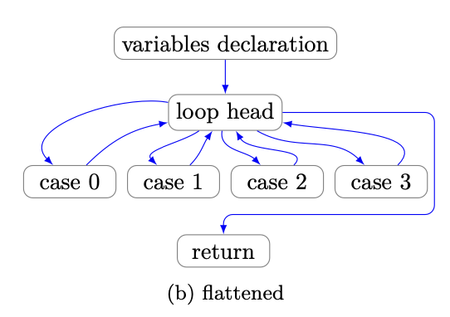
Control Flow Flattening (CFF): example

Slide 22
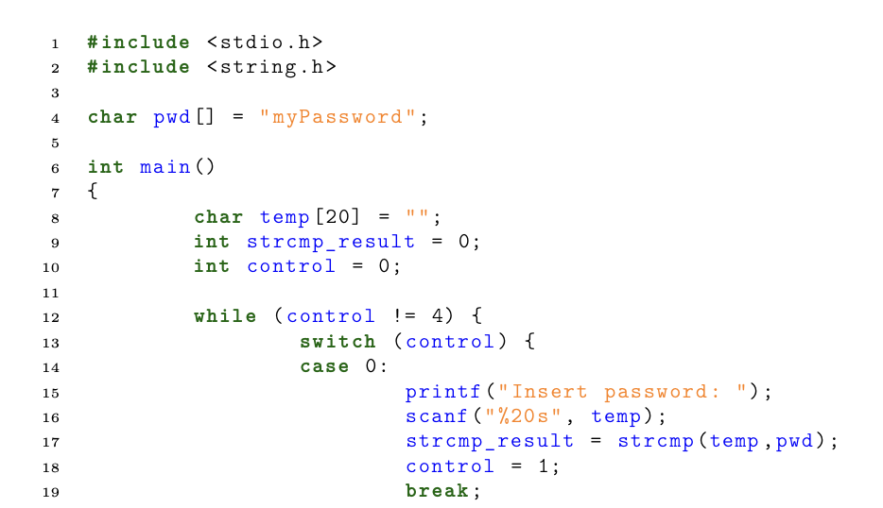
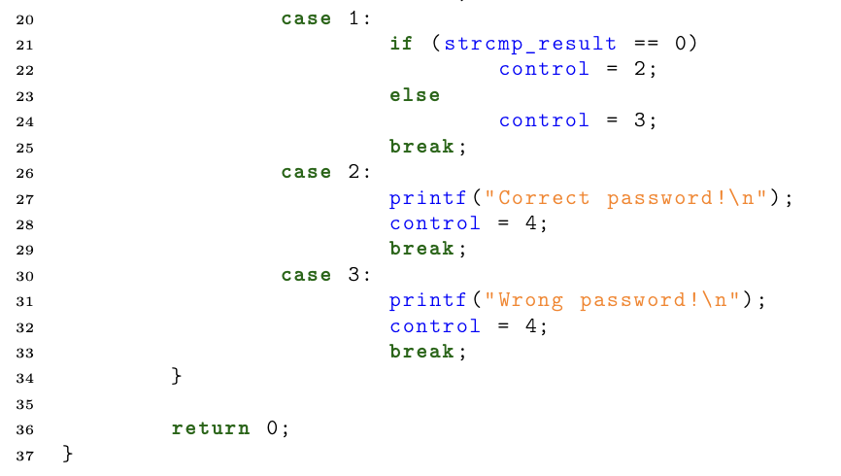
Control Flow Flattening (CFF): example

Slide 23
Opaque Predicates
boolean expressions that have always the same outcome at run-time
e.g., always true or always false
their outcome is difficult to evaluate in a static way
e.g., by deobfuscators
if employed as the condition of a branch
difficult to take the branch taken without executing the program
fuzzying the program can indicate the likely presence of an opaque predicate
but without any formal assurance

Slide 24
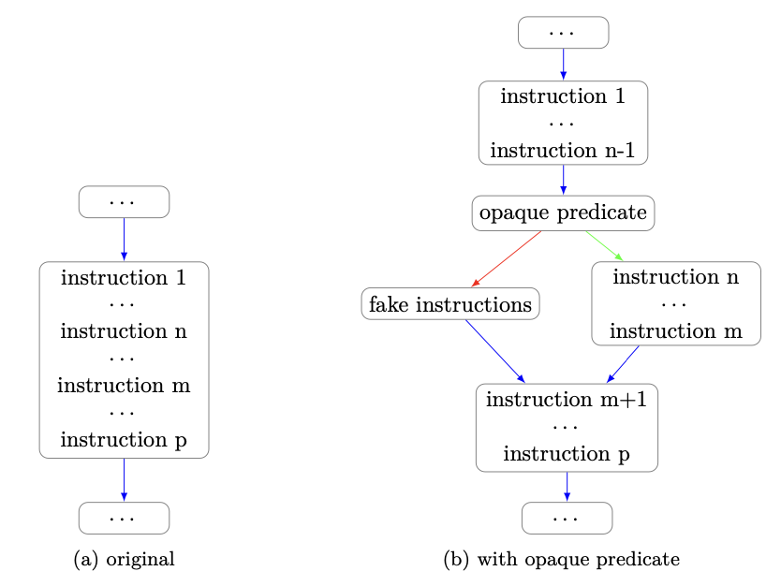
Opaque Predicates: fake code insertion
we can leverage opaque predicates to insert fake code
in order to increase the amount of code the attacker needs to understand
we can also use the technique to split basic blocks
to hinder comprehension of contained code
the attacker will think that there is some decision logic where there is none
in figure we use a opaque predicate for both purposes
the red branch will never be taken

Slide 25
Opaque Predicates: practical implementations
diablo (binary-to-binary obfuscator)
predicates based on mathematical properties of conditional expression
e.g. x² ≥ 0 (but they are more complex than this example)
fast runtime evaluation (low overhead) yet difficult to prove formally
the attacker may study the obfuscator to recognize the hardcoded predicates …
… thus predicates instruction generation is randomized
use of dead registers
constant randomization (x² ≥ N with random N ≥ 0)

Slide 26
Opaque Predicates: practical implementations
tigress (source-to-source obfuscator)
conditions on pointers to data structures
custom data structures added to code for this purpose
example: consider two completely separated linked lists L1 and L2
we can define three pointers:
p1 and p2 point to nodes of L1
p3 pointing to an element of L2
we can add to program code instructions that move pointers to other nodes, but of the same list
we can define two possible kinds of opaque predicates
p1 != p3 and p2 != p3 → always true, we can use it for fake code insertion
p1 == p2 → true or false, depending on initial nodes pointed and consequent movement instructions
user should define the function initializing the data structures
should be executed before functions containing opaque predicates (e.g. main)
user should define the functions updating pointers/data structure
more updates, more complexity (good!) but more overhead at runtime (bad…)

Slide 27
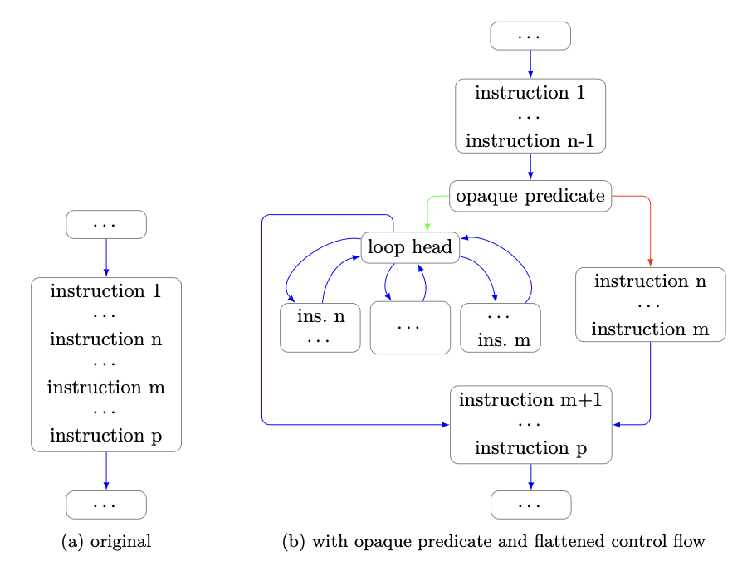
Opaque Predicates: code duplication
second kind of opaque predicate can be leveraged to duplicate code
we take the original basic block and we flatten it
we use the opaque predicate to insert both the original and the flattened version
with this kind of opaque predicate we don’t know which branch will be taken at runtime
and that’s fine: same code logic
the attacker needs to analyze the opaque predicate logic and the duplicated code

Slide 28
Branch functions
decrease the accuracy of static disassemblers
disassemblers: tools to translate binary code in human-readable assembly
static disassemblers
dynamic disassemblers: inspect code execution through debugging
problem: only executed code can be translated
problem: slower w.r.t. static disassembly
can be thwarted by anti-debugging protections
static disassembly techniques
linear sweep (e.g. objdump)
decode instruction linearly, starting from the first byte of text section
next instruction address = current pointer + expected_length(current instruction)
problem: not always accurate
e.g., constants in text section mistaken for instructions
recursive traversal
decode instructions following the program control flow, i.e. jumps
in case of branches, follow all possible flows
problem indirect jumps (e.g. JMP EAX → what is the value of EAX?)
techniques to cover common ind. jumps cases (e.g. jump tables created from source switch statements)

Slide 29
Branch functions
decrease the accuracy of static disassemblers
by transforming direct jumps in indirect jumps…
… and increasing the difficulty of indirect jumps target reconstruction
indirect jumps transformed into calls to a branch function
branch function will transfer program control to the substituted jump target
branch functions must know how to select jump target
easy implementation: jump table
index of correct target as argument of branch function
easy to implement, yet easy to reverse
complex implementation: Linn/Debray
based on perfect hashing
perfect hash function performs transformation jump_address → target_address
Tigress implementation
branch function receives offset: function_call_address – original_target _address
implementation based on pointer arithmetic
https://www2.cs.arizona.edu/~debray/Publications/disasm-resist.pdf

Slide 30
Virtualization obfuscation
transforms the code to protect so that real opcodes are hidden ◦ translates instructions in a specially devised instruction set
uses different opcodes, e.g., randomly selected
similar to executing code in a virtual machine
turns a function into an interpreter, whose bytecode language is specialized for this function
induces as much diversity as possible
each interpreter variant differs in the structure of its code as well as in its execution pattern
at run-time, the code execution is delegated to the interpreter
translates each instruction that must be executed from the “virtual instruction set” to the original one
to be executed by the actual CPU

Slide 31
Virtualization obfuscation
an attacker needs to reconstruct the mapping between the virtual and the original instruction set
mapping can be automated by means of dynamic analysis
in practice, this is the only obfuscation for which deobfuscators exist
there are engineering tricks to prevent or make difficult the mapping
superoperators = virtual instructions that translate in sequences of instructions
avoid 1-1 mapping, which would be too easy to reconstruct

Slide 32
Just-In-Time opcode generation
translates a function F into a new function F’
some blocks prepare the execution of the next blocks
e.g., XOR a piece of the code segment with some data or previously executed instructions ◦ runtime code generation / dynamic unpacking
violate the W^X security principle of OSes
Write XOR Execute: a memory page can be writable or executable, but not both
variants: jitted code continuously modified and updated at runtime
different approaches
Aucsmith’s, Cappaert’s, Kanzaki’s, Madou’s, Collberg’s
e.g., XOR with a mask
e.g., decrypt the next basic block using a key computed by the current basic block (CryptoGuards)

Slide 33
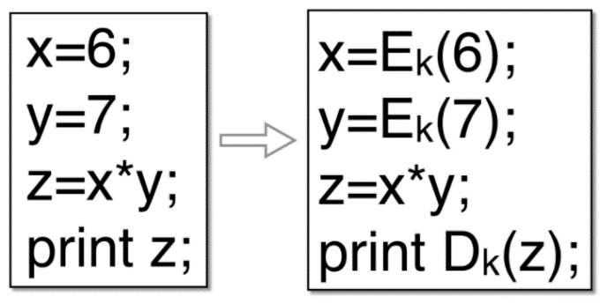
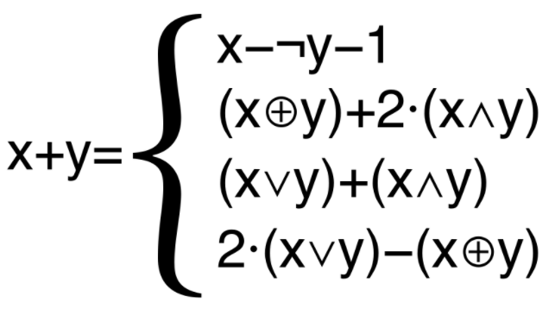
Data obfuscation
this obfuscation works on data, objective:
prevent understanding of the value of the constants present in source code
during static code analysis
prevent understanding of the value of variables during the execution
during dynamic analysis
constants: ad hoc techniques depending on data types
integers vs. strings
e.g., uses systems of equations for integers
automata to generate the strings
variables: change the representation in memory
use ad hoc encoding mathematical function
e.g. based on mixed Boolean-arithmetic transforms, modular arithmetic
if you want more info/examples on mathematical transforms
look at papers cited on Tigress documentation page
https://tigress.wtf/encodeData.html
Notes:
[1] Yongxin Zhou et al. “Information Hiding in Software with Mixed Boolean-Arithmetic Transforms”. In: Information Security Applications. Ed. by Sehun Kim, Moti Yung, and Hyung-Woo Lee. Berlin, Heidelberg: Springer Berlin Heidelberg, 2007, pp. 61–75. isbn: 978-3-540-77535-5.
[2] Arun Narayanan Kandanchatha and Yongxin Zhou. “System and method for obscuring bit-wise and two’s complement integer computations in software”. US Patent 7966499. July 2005. url: https://patents.google.com/patent/US7966499
[1] Yongxin Zhou et al. “Information Hiding in Software with Mixed Boolean-Arithmetic Transforms”. In: Information Security Applications. Ed. by Sehun Kim, Moti Yung, and Hyung-Woo Lee. Berlin, Heidelberg: Springer Berlin Heidelberg, 2007, pp. 61–75. isbn: 978-3-540-77535-5.
[2] Arun Narayanan Kandanchatha and Yongxin Zhou. “System and method for obscuring bit-wise and two’s complement integer computations in software”. US Patent 7966499. July 2005. url: https://patents.google.com/patent/US7966499

Slide 34
Literals obfuscation: Tigress implementation
integer constants obfuscation
based on opaque predicates
e.g. how to obfuscate constant with value 0 → p1 == p2
op. pred. with pointers on linked lists that is always false
Boolean false in C is treated as a 0
string literals obfuscation
transformed into calls to an encoder function
the encoder function will generate literals at run-time
blocks attacker search for literals (e.g. Linux command strings)
finding strings first step in attacker (e.g. finding “Wrong password!” in previous example)
encoder function logic very easy to understand for attacker
also easy to find
e.g. will see a call to this function every time a string is printed to console
we can protect the function with code obfuscation
Notes:
[1] Yongxin Zhou et al. “Information Hiding in Software with Mixed Boolean-Arithmetic Transforms”. In: Information Security Applications. Ed. by Sehun Kim, Moti Yung, and Hyung-Woo Lee. Berlin, Heidelberg: Springer Berlin Heidelberg, 2007, pp. 61–75. isbn: 978-3-540-77535-5.
[2] Arun Narayanan Kandanchatha and Yongxin Zhou. “System and method for obscuring bit-wise and two’s complement integer computations in software”. US Patent 7966499. July 2005. url: https://patents.google.com/patent/US7966499
[1] Yongxin Zhou et al. “Information Hiding in Software with Mixed Boolean-Arithmetic Transforms”. In: Information Security Applications. Ed. by Sehun Kim, Moti Yung, and Hyung-Woo Lee. Berlin, Heidelberg: Springer Berlin Heidelberg, 2007, pp. 61–75. isbn: 978-3-540-77535-5.
[2] Arun Narayanan Kandanchatha and Yongxin Zhou. “System and method for obscuring bit-wise and two’s complement integer computations in software”. US Patent 7966499. July 2005. url: https://patents.google.com/patent/US7966499

Slide 35
Other techniques
protections that prevent the use of specific tools (but are not considered a form of obfuscation)
e.g. anti-debugging protections
anti-tampering
local checks: code guards
remote techniques: software and remote attestation
use remote server to perform verifications of integrity data produced at the client
technique that limit the code available at the client
no static analysis without the full code
no stand-alone dynamic analysis
(diversified) pieces of code sent to the client only after the program starts
code mobility
some functions only executed on the server
client-server code splitting

Slide 36
Anti-debugging
debuggers among most common tools used by attackers, useful for:
reverse engineering
dynamic inspection of application behavior
collection of execution traces for further analysis
code tampering
halt application execution
modify memory locations (code or data sections)
resume application with altered logic
anti-debugging: prevent a debugger from being attached to protected application
all techniques based on same assumption:
cannot attach more than one debugger at the same time
basic (and practically useless) implementation
a debugger must call ptrace syscall to attach to target process
ptrace(PTRACE_ATTACH,pid,0,0)
program can ask to not be debugged by calling prctl syscall with following arguments
prctl(PR_SET_DUMPABLE ,SUID_DUMP_DISABLE ,0,0,0)
this resets a flag in /proc/sys/fs/suid_dumpable
easy circumvention by attacker: set flag again after program calls prctl
Notes:
B. Abrath, B. Coppens, S. Volckaert, J. Wijnant, and B. D. Sutter, “Tightly-coupled self-debugging software protection,” in Proc. of the 6th Workshop on Software Security, Protection, and Reverse Engineering (SSPREW’16), Los Angeles, California, USA. ACM Press, December 2016, pp. 7:1–7:10.

Slide 37
Anti-debugging: self-debugging
application includes a self-debugger
the self-debugger attaches to main process immediately after starting execution
attacker must remove the self-debugger to attach his own debugger
part of instruction logic moved to self-debugger
application stop behaving correctly if self-debugger is simply removed
simple schema (used to protect Starcraft II)
some jump instructions substituted with debug exceptions
exception includes the original program address launching the exception
control passes to self-debugger
static mapping: debug exception address → original jump instruction target address
easily circumvented: static analysis to locate debug exception handlers and reconstruct original jump instructions
Notes:
B. Abrath, B. Coppens, S. Volckaert, J. Wijnant, and B. D. Sutter, “Tightly-coupled self-debugging software protection,” in Proc. of the 6th Workshop on Software Security, Protection, and Reverse Engineering (SSPREW’16), Los Angeles, California, USA. ACM Press, December 2016, pp. 7:1–7:10.

Slide 38
Anti-debugging: Diablo self-debugging
complex schema
patented but free for non-commercial use
whole parts of protected application code can be moved to the self-debugger
when execution arrives to moved code → debug exception launched
self-debugger copies target process context (e.g. CPU register values)
self-debugger executes instructions
can read/write protected process memory with syscall ptrace
called with constants PTRACE_PEEKDATA and PTRACE_POKEDATA
removing Diablo self-debugger is not trivial
attacker should restore moved instructions in their original position in binary
problem: moved instructions do not use the original CPU registers
problem: memory read/write instructions substituted with self-debugger routines
using internal ptrace syscalls with PTRACE_PEEKDATA and PTRACE_POKEDATA constants
Notes:
B. Abrath, B. Coppens, S. Volckaert, J. Wijnant, and B. D. Sutter, “Tightly-coupled self-debugging software protection,” in Proc. of the 6th Workshop on Software Security, Protection, and Reverse Engineering (SSPREW’16), Los Angeles, California, USA. ACM Press, December 2016, pp. 7:1–7:10.

Slide 39
Anti-tampering
category of protections that aim at making code changes more complex
changes should come with a cost
security property
integrity (e.g., of the code)
execution correctness: much more complex to obtain
different families of protections
local vs. remote
local if all the components are in the program
remote if they resort to external components (e.g., servers as the root of trust)
with or without secure hardware/secure coprocessors
when available, some computations can be offloaded to pieces of HW that cannot be tampered without local intervention

Slide 40
Software attestation
verify that a program running on another system is behaving as expected
secure HW is not used or not available
better for portable devices, IoT, embedded systems, etc.
usually implemented as “application integrity”
hypothesis: if binaries are correct, then also the application will behave correctly
checksum of the binary or configuration files stored in the file system
checksum of the binary loaded in memory
checked at load- or run-time
vulnerable to several attacks
dynamic code injection (i.e., with debuggers)
parallel execution of an untampered version of the device
Notes:
[1] F. Armknecht, A.-R. Sadeghi, S. Schulz, and C. Wachsmann, “A security framework for the analysis and design of software attestation,” in Proc. of the 2013 ACM SIGSAC conf. on Computer and Communications Security (CCS’13), Berlin, Germany. ACM, November 2013, pp. 1–12.

Slide 41
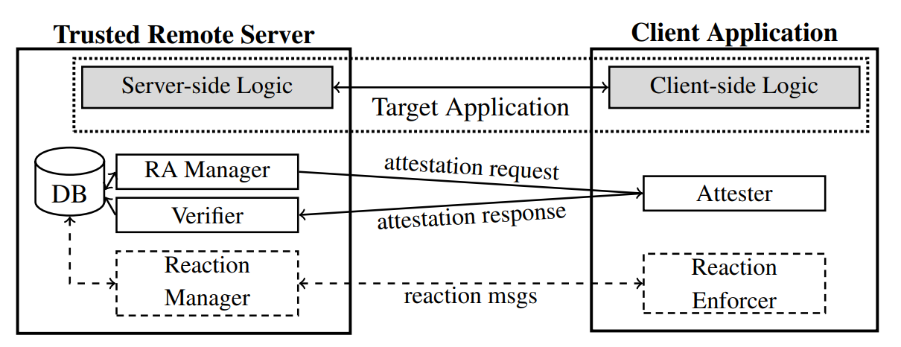
Software attestation: architecture
Notes:
[1] F. Armknecht, A.-R. Sadeghi, S. Schulz, and C. Wachsmann, “A security framework for the analysis and design of software attestation,” in Proc. of the 2013 ACM SIGSAC conf. on Computer and Communications Security (CCS’13), Berlin, Germany. ACM, November 2013, pp. 1–12.

Slide 42
Software attestation
much better achieving execution correctness
but much more difficult to have evidence of execution correctness
different approaches proposed in the literature
built on different roots of trust / types of evidence
the properties that allow telling good from compromised applications
require a formal model of the application behaviour
usually not available, only for very small pieces of the application to protect may have it
examples
measurement of the time spent to execute a particular piece of code
likely invariants monitoring
which is not effective, as proved by a recent paper
checks that CFG branches are executed in the correct order
often very trivial (e.g., counters)
Notes:
[1] T. Jaeger, R. Sailer, and U. Shankar, “PRIMA: policy-reduced integrity measurement architecture,” in Proc. of the 11th ACM symposium on Access control models and technologies (SACMAT’06), Tahoe City, California, USA. ACM, June 2006, pp. 19–28.
[2] A. Seshadri, M. Luk, E. Shi, A. Perrig, L. van Doorn, and P. Khosla, “Pioneer: verifying code integrity and enforcing untampered code execution on legacy systems,” ACM SIGOPS Operating Systems Review, vol. 39, no. 5, pp. 1–16, October 2005.
[3] A Viticchié, C Basile, F Valenza, A Lioy “On the impossibility of effectively using likely-invariants for software attestation purposes.” J. Wirel. Mob. Networks Ubiquitous Comput. Dependable Appl. 9 (2), 1-25

Slide 43
Remote attestation
methodology used to verify that a program running on another system is behaving as expected
…but with secure HW
TPM or other secure coprocessors
Intel SGX or ARM TrustZone used to have a root of trust
the most widespread approach defined by the Trusted Computing Group
TPM + well defined components + architecture + protocols
https://trustedcomputinggroup.org/wp-content/uploads/TCG_1_4_Architecture_Overview.pdf
workflow
attest the BIOS, then the loader, then the OS, then attest all the security sensitive applications, …
current RA methodologies limit functionality...
does not scale well for virtualization (e.g., for software networks)
new results available that seem to impact this field
in the best case, usability is very affected
Notes:
[1] G. Coker, J. Guttman, P. Loscocco, A. Herzog, J. Millen, B. O’Hanlon, J. Ramsdell, A. Segall, J. Sheehy, and B. Sniffen, “Principles of remote attestation,” International Journal of Information Security, vol. 10, no. 2, pp. 63–81, April 2011.
[2] R. Sailer, X. Zhang, T. Jaeger, and L. Van Doorn, “Design and implementation of a TCG-based integrity measurement architecture.” in Proc. of the 13th Conference on USENIX Security Symposium (SSYM’04), Berkeley, California, USA, vol. 13. USENIX Association, August 2004, pp. 223–238.

Slide 44
Code guards
pieces of code injected into the application
check other pieces of code of the same program for specific code properties
if checks are OK the program is assumed to be uncompromised
examples of checks
hash of bytes in memory (code or data)
hash of the executed instructions for unconditional code blocks
crypto guards: the next block is correctly decrypted if the previously executed blocks are the correct ones
reactions prevent the correct execution of the rest of the application
graceful degradation
faults / crashes
reactions must be delayed to avoid the attacker to defeat them
or you have to resort to remote servers
Notes:
[1] D. Aucsmith, Tamper Resistant Software: An Implementation, in Proceedings of the First International Workshop on Information Hiding, May 1996
[2] H. Chang and M. Atallah, Protecting Software Code by Guards, in Proceedings of the Workshop on Security and Privacy in Digital Rights Management, November 2001
[3] Jan Cappaert, Bart Preneel, Bertrand Anckaert, Matias Madou, and Koen De Bosschere, “Towards Tamper Resistant Code Encryption: Practice and Experience”, In Information Security Practice and Experience, 4th International Conference, ISPEC 2008, Lecture Notes in Computer Science 499
[4] Chen Y., Venkatesan R., Cary M., Pang R., Sinha S., Jakubowski M.H. (2003) Oblivious Hashing: A Stealthy Software Integrity Verification Primitive. In: Petitcolas F.A.P. (eds) Information Hiding. IH 2002. Lecture Notes in Computer Science, vol 2578. Springer, Berlin, Heidelberg

Slide 45
Code mobility
an online anti-RE+anti-tampering technique where the program is shipped without pieces of code
a local binder understands when a piece of code needs to be executed
a downloader obtains it from a trusted server
the downloaded code blocks become part of the application
they may be discarded when the application is stopped
mobile blocks are usually security-sensitive pieces of code
may be protected
can be replaced
diversification techniques used to obtain sets of blocks with the same semantics
not always the same “cuts”
e.g., barrier slicing
Notes:
Alessandro Cabutto et al. “Software Protection with Code Mobility”. In: Proceedings of the Second ACM Workshop on Moving Target Defense. MTD ’15. Denver, Colorado, USA: ACM, 2015, pp. 95–103. isbn: 978-1-4503-3823-3. doi: 10.1145/2808475.2808481. url: http://doi.acm.org/10.1145/2808475.2808481.

Slide 46
Client-Server Code Splitting
splits code of the application to protect
part of the code is executed on a trusted server
the sensitive ones
client and server code is interleaved
the server performs a sort of remote computation for each application
proved with empirical experiments that it is better to split several small pieces
instead of big blocks with all the sensitive parts
more confusion and more links to follow
problem: device should always be online to execute application
not a very big problem nowadays
can limit deployment to most sensitive algorithms
problem: server overhead
delay introduced if high-load on server
potential risk of DoS
Notes:
[1] M. Ceccato, M. Dalla Preda, J. Nagra, C. Collberg, and P. Tonella. Barrier slicing for remote software trusting. In Seventh IEEE International Working Conference on Source Code Analysis and Manipulation (SCAM 2007), pages 1–10, Paris, France, 2007. IEEE Computer Society.
[2] A Viticchié, L Regano, C Basile, M Torchiano, M Ceccato, P Tonella “Empirical assessment of the effort needed to attack programs protected with client/server code splitting” Empirical Software Engineering 25 (1), 1-48

Slide 47
Techniques for diversification
generates different semantically equivalent copies of code blocks
up to functions and entire programs
avoid that exploits extend to large number of copies of the same software
risk mitigation
only a limited set of program copies are affected by a given exploit
obtained in different manners
different compilation options
generators of diversity
obfuscating the code to diversify with different techniques
also using different parameters
Notes:
[1] B. Coppens, B. De Sutter, J. Maebe, “Feedback-driven binary code diversification” ACM Trans. Archit. Code Optim., 9 (4) (2013), pp. 24:1-24:26

Slide 48
Software protection as a risk analysis process
unprotected application (source code)
NIST SP800-39 risk management process
general standard for risk management
comprises four phases
risk framing
risk assessment
risk mitigation
risk monitoring
asset identification
RISK FRAMING
source code analysis
threat identification
RISK ASSESSMENT
risk evaluation and prioritization
decision making
RISK MIITIGATION
deployment
RISK MONITORING
protected application
server-side logic
C. Basile, B. De Sutter, D. Canavese, L. Regano, B. Coppens, “Design, Implementation, and Automation of a Risk Management Approach for Man-at-the-End Software Protection”, Computers & Security, 2023
Notes:
[1] B. Coppens, B. De Sutter, J. Maebe, “Feedback-driven binary code diversification” ACM Trans. Archit. Code Optim., 9 (4) (2013), pp. 24:1-24:26

Slide 49
Software protection as a risk analysis process
unprotected application (source code)
Risk framing: establish the scenario in which the risk must be managed
MATE scenario
attacker has complete control of machine executing target application
define the expected attacker expertise
e.g. based on the assets’ monetary value
define the assets inside the application
specify their importance (or weight)
specify their type (code, vars, crypto keys, etc.)
define security requirements of assets
CIA triad (mainly confidentiality and integrity)
analyze the source code
define application business logic, CFG, CG, DDG, etc.
identify external libraries
all useful info for next steps
asset identification
RISK FRAMING
source code analysis
threat identification
RISK ASSESSMENT
risk evaluation and prioritization
decision making
RISK MIITIGATION
deployment
RISK MONITORING
protected application
server-side logic
Notes:
[1] B. Coppens, B. De Sutter, J. Maebe, “Feedback-driven binary code diversification” ACM Trans. Archit. Code Optim., 9 (4) (2013), pp. 24:1-24:26

Slide 50
Software protection as a risk analysis process
unprotected application (source code)
Risk assessment: identify threats against the system assets, vulnerabilities of the system, the harm that may occur if such vulnerabilities are exploited, and the likelihood this would happen
threat identification: possible attacks endangering assets’ security requirements
formally model them (e.g. attack trees)
risk evaluation and prioritization
rank possible attacks in function of their risk
considering their likelihood
account for attacker expertise
considering the endangered asset weight
asset identification
RISK FRAMING
source code analysis
threat identification
RISK ASSESSMENT
risk evaluation and prioritization
decision making
RISK MIITIGATION
deployment
RISK MONITORING
protected application
server-side logic
Notes:
[1] B. Coppens, B. De Sutter, J. Maebe, “Feedback-driven binary code diversification” ACM Trans. Archit. Code Optim., 9 (4) (2013), pp. 24:1-24:26

Slide 51
Software protection as a risk analysis process
unprotected application (source code)
Risk mitigation: determine and implement appropriate actions to mitigate the risks
decision making: decide which protection techniques should be applied to protect the assets
very, very complex process
ideally, to protect against all attacks found in risk assessment phase
depending on asset type, possible attacks, attacker expertise, available overhead
layered protections
order among layered protections is also important!
deployment: deploy chosen protections
either manually or with automated tools
check that application still work, and it is still usable
otherwise go back to decision making…
asset identification
RISK FRAMING
source code analysis
threat identification
RISK ASSESSMENT
risk evaluation and prioritization
decision making
RISK MIITIGATION
deployment
RISK MONITORING
protected application
server-side logic
Notes:
[1] B. Coppens, B. De Sutter, J. Maebe, “Feedback-driven binary code diversification” ACM Trans. Archit. Code Optim., 9 (4) (2013), pp. 24:1-24:26

Slide 52
Software protection as a risk analysis process
unprotected application (source code)
Risk monitoring: verify that the implemented actions are effective in mitigating the risks
test the resilience of deployed protections before/after releasing application
tiger/red teams: highly skilled white-hat hackers performing penetration testing
if you have time, use the results to go back in the process (potentially to risk framing) and refine the results
server-side logic of online protections may be used for monitoring purposes
if application has been tampered with, send an alert to base
monitor Internet/DarkNet resources
e.g. if application has a license check, look for cracks…
asset identification
RISK FRAMING
source code analysis
threat identification
RISK ASSESSMENT
risk evaluation and prioritization
decision making
RISK MIITIGATION
deployment
RISK MONITORING
protected application
server-side logic
Notes:
[1] B. Coppens, B. De Sutter, J. Maebe, “Feedback-driven binary code diversification” ACM Trans. Archit. Code Optim., 9 (4) (2013), pp. 24:1-24:26

Slide 53
Asset Hiding
problem: software protections might expose a ''fingerprint''
fingerprints: code patterns, peculiar behaviors, etc.
attackers locate assets looking for protection fingerprints
solution: Asset Hiding (AH) phase
apply protections to hide fingerprints
trade-off between fingerprint hiding and overhead
state of the art: manually obfuscate as much code as possible
L. Regano, D. Canavese, C. Basile, A. Lioy, Towards Optimally Hiding Protected Assets in Software Applications,
2017 IEEE International Conference on Software Quality, Reliability and Security (QRS), 2017
Notes:
[1] B. Coppens, B. De Sutter, J. Maebe, “Feedback-driven binary code diversification” ACM Trans. Archit. Code Optim., 9 (4) (2013), pp. 24:1-24:26

Slide 54
Fingerprint example: Control Flow Flattening
14/19
…
…
BB 1
loop head
BB 2
BB 3
BB 2
BB 4
BB 1
BB 3
BB 4
BB 5
BB 5
…
…
Notes:
basic block = sequences of consecutive instruction always executed together in the same order, that is no jumps in between

Slide 55
Fingerprint example: Control Flow Flattening
14/19
fingerprint
Notes:
basic block = sequences of consecutive instruction always executed together in the same order, that is no jumps in between

Slide 56
Asset hiding phase: strategies
binary code
Asset Hiding strategies:
fingerprint replication
protected area enlargement
fingerprint shadowing
deciding AH protections is difficult:
not all strategies are useful to hide all protections
some strategies may lower AP protections security
overhead must be taken into account
asset
asset
Notes:
anti-debugging can be replicated -> evident system call
enlargement of existing obfuscated areas -> increase the critical section, the asset is there, but the attacker must analyze more code
control flow flattening evident CFG structure -> can be shadowed by opaque predicates, they alter the CFG
example of virtualization -> the protection relies on the confidentiality of the mapping between the original and the VM instruction set, if I replicate too much the attacker has more info to reconstruct the mapping

